Slide 1
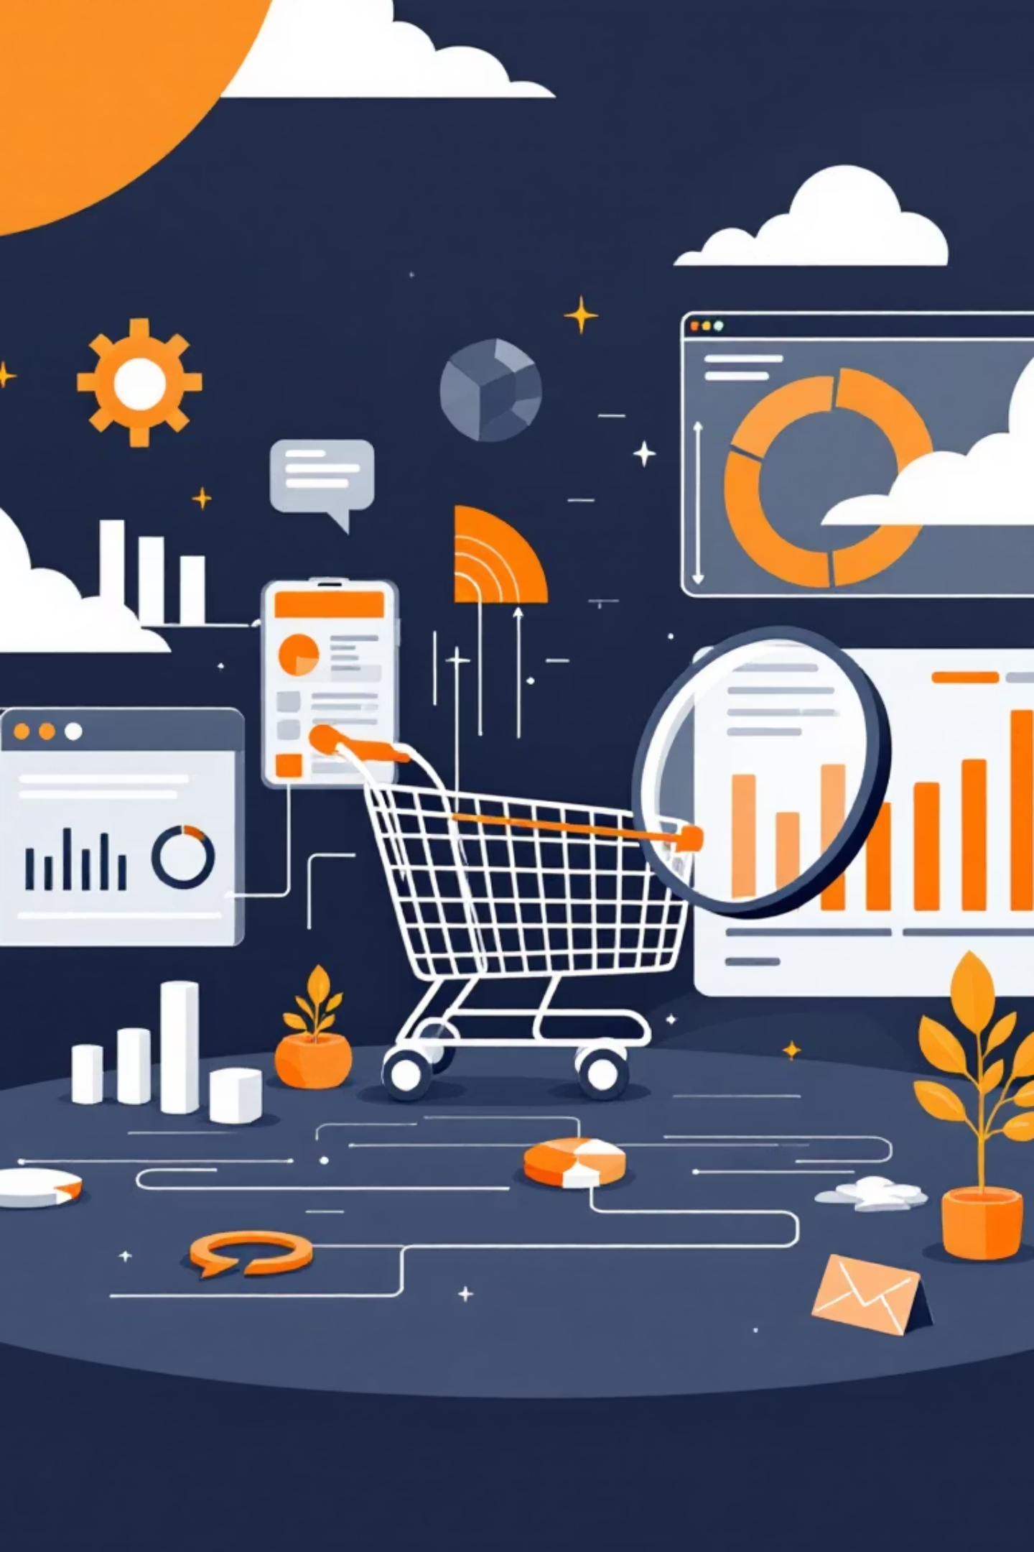
Customer Shopping Behavior Analysis
Uncovering insights from transactional data to guide strategic business decisions.

Slide 2
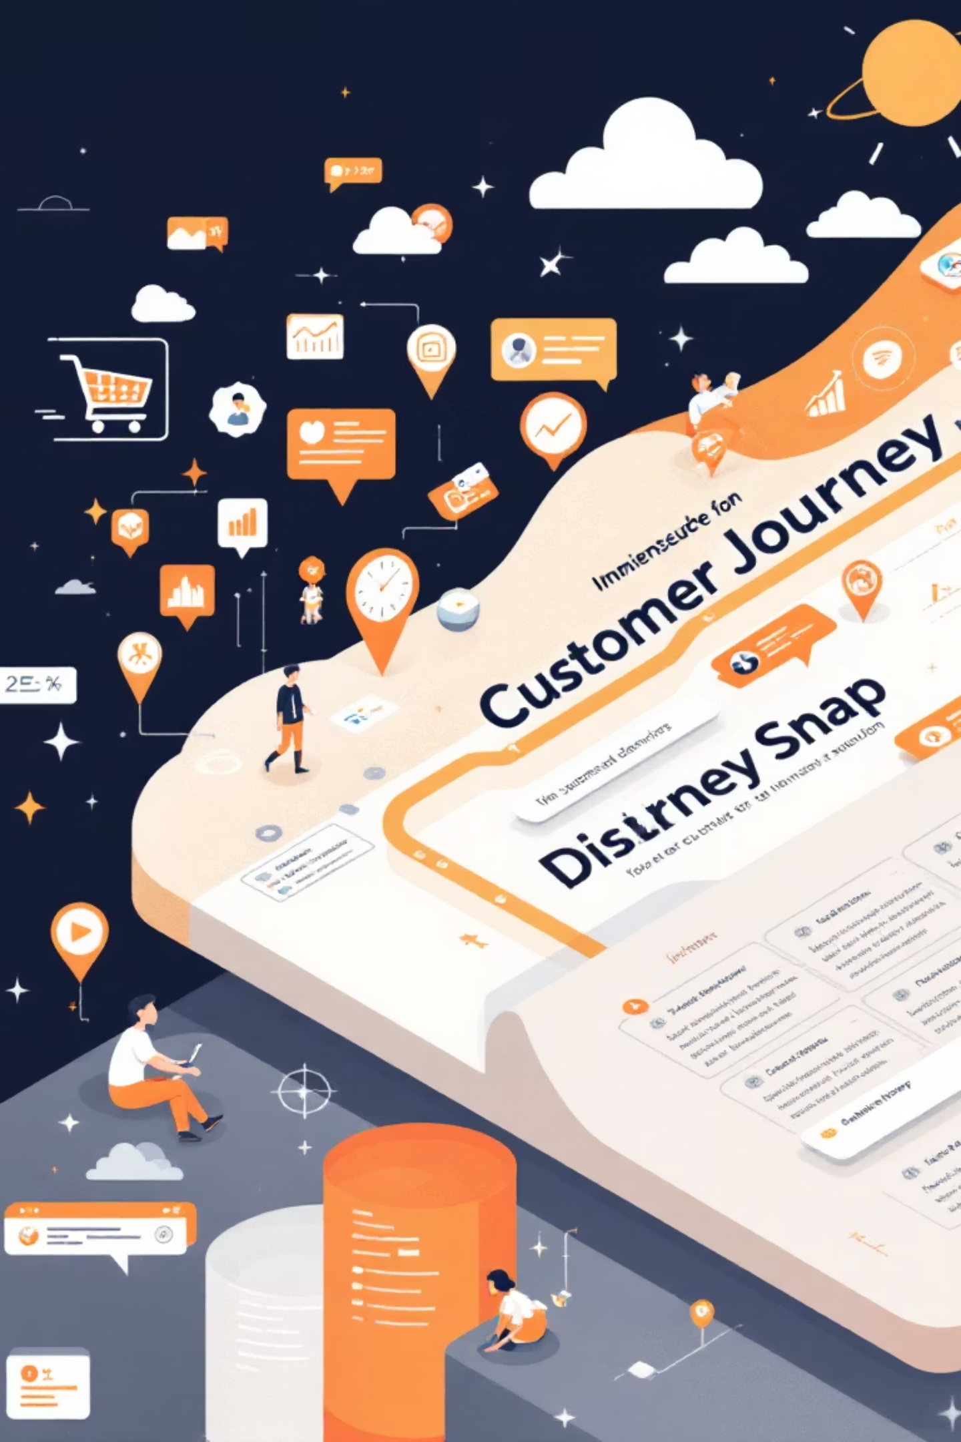
Project Overview
Data Source
Key Goal
Transactional data from 3,900 purchases.
Uncover spending patterns, customer segments, product preferences.
Strategic Impact
Guide business decisions and optimize operations.

Slide 3
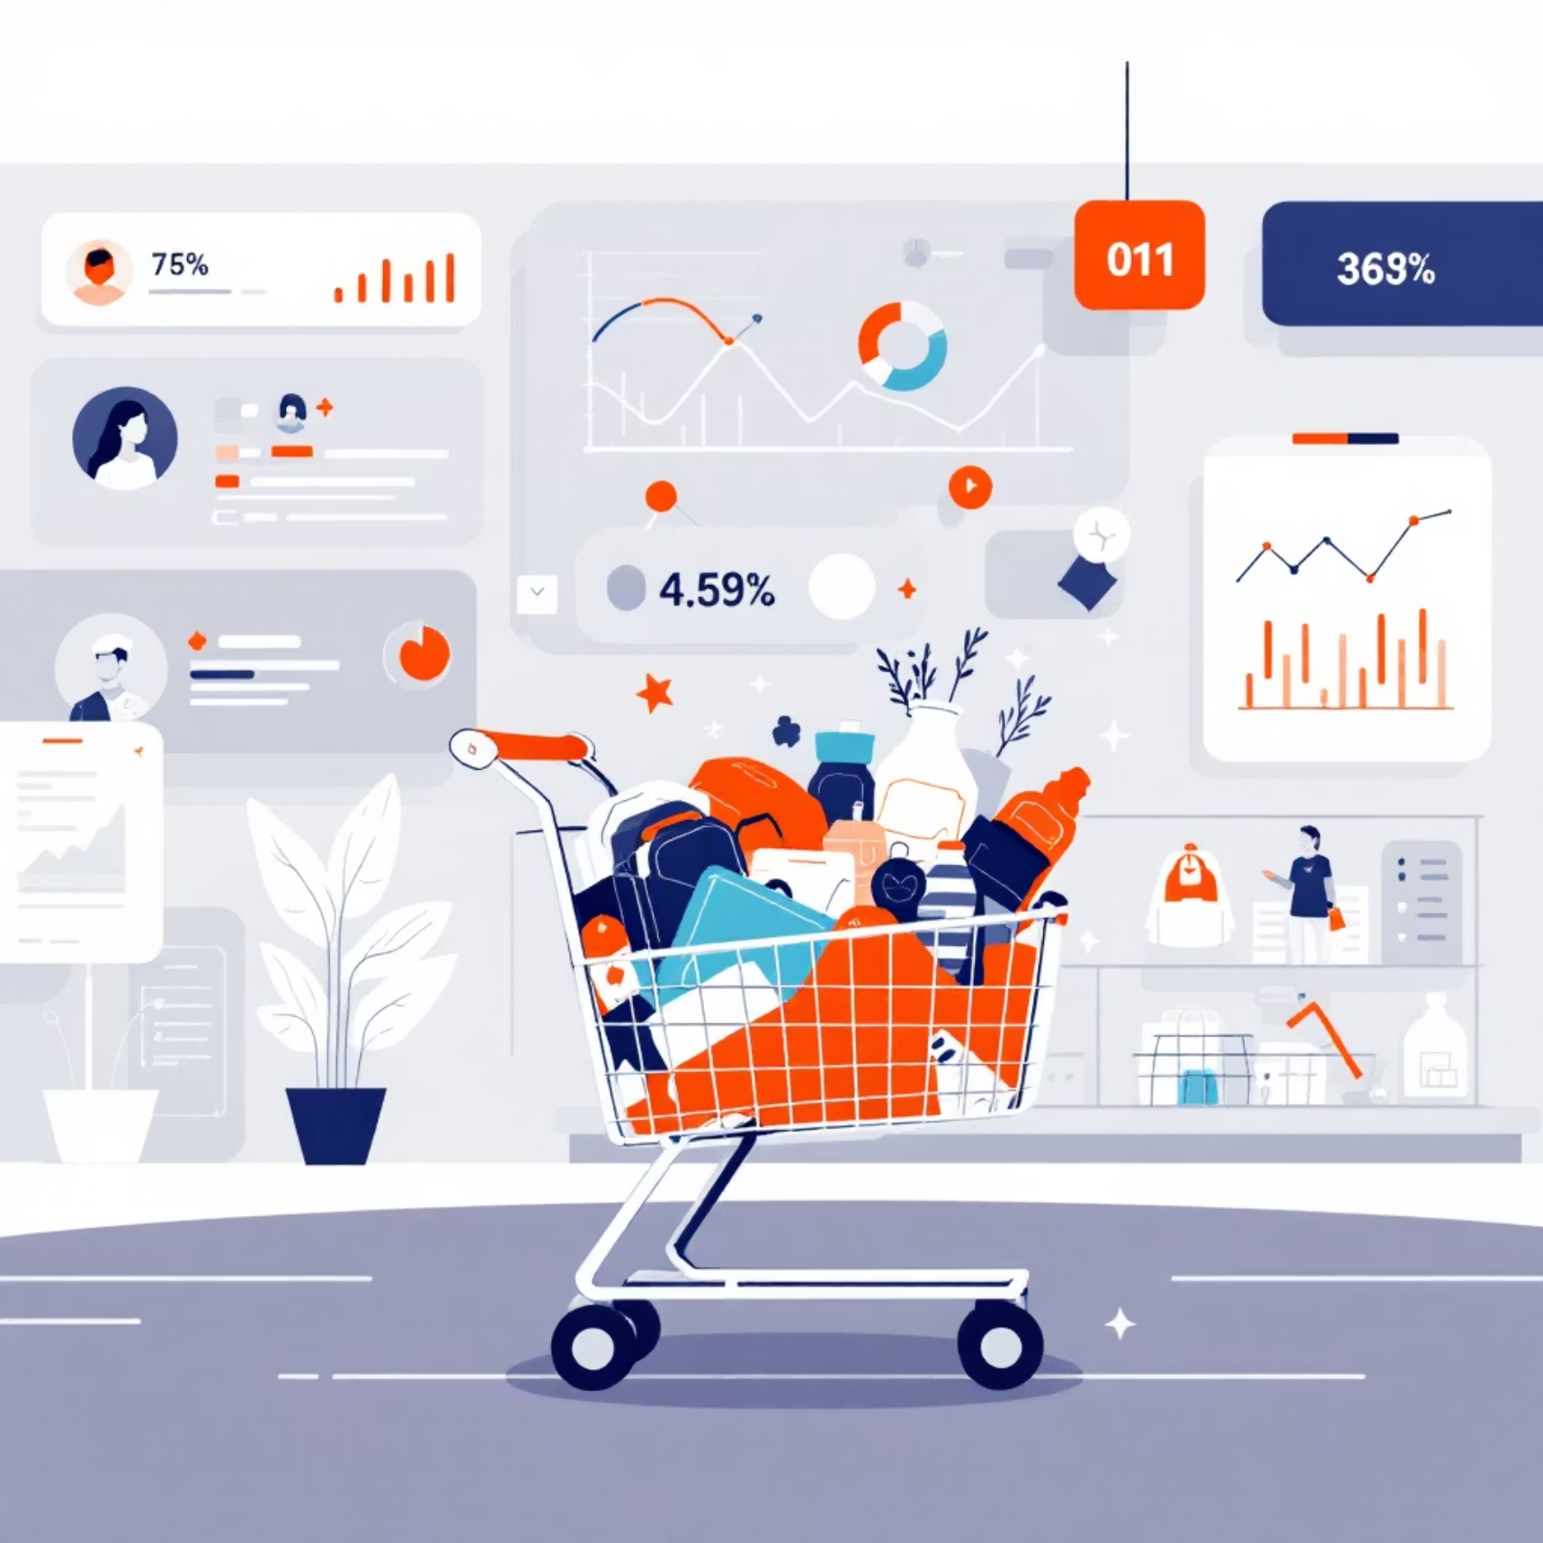
Dataset Summary
Key Features
Customer demographics (Age, Gender, Location, Subscription)
Purchase details (Item, Category, Amount, Season, Size, Color)
Shopping behavior (Discount, Promo, Previous Purchases, Frequency, Review, Shipping)
Missing Data
37 values in Review Rating column.

Slide 4
Exploratory Data Analysis (Python)
01
02
03
Data Loading & Exploration
Missing Data Handling
Column Standardization
Imported with pandas, checked structure and summary statistics.
Imputed Review Rating using median by product category.
Renamed columns to snake_case for readability.
04
05
Feature Engineering
Database Integration
Created age_group and purchase_frequency_days.
Loaded cleaned data to PostgreSQL for SQL analysis.

Slide 5
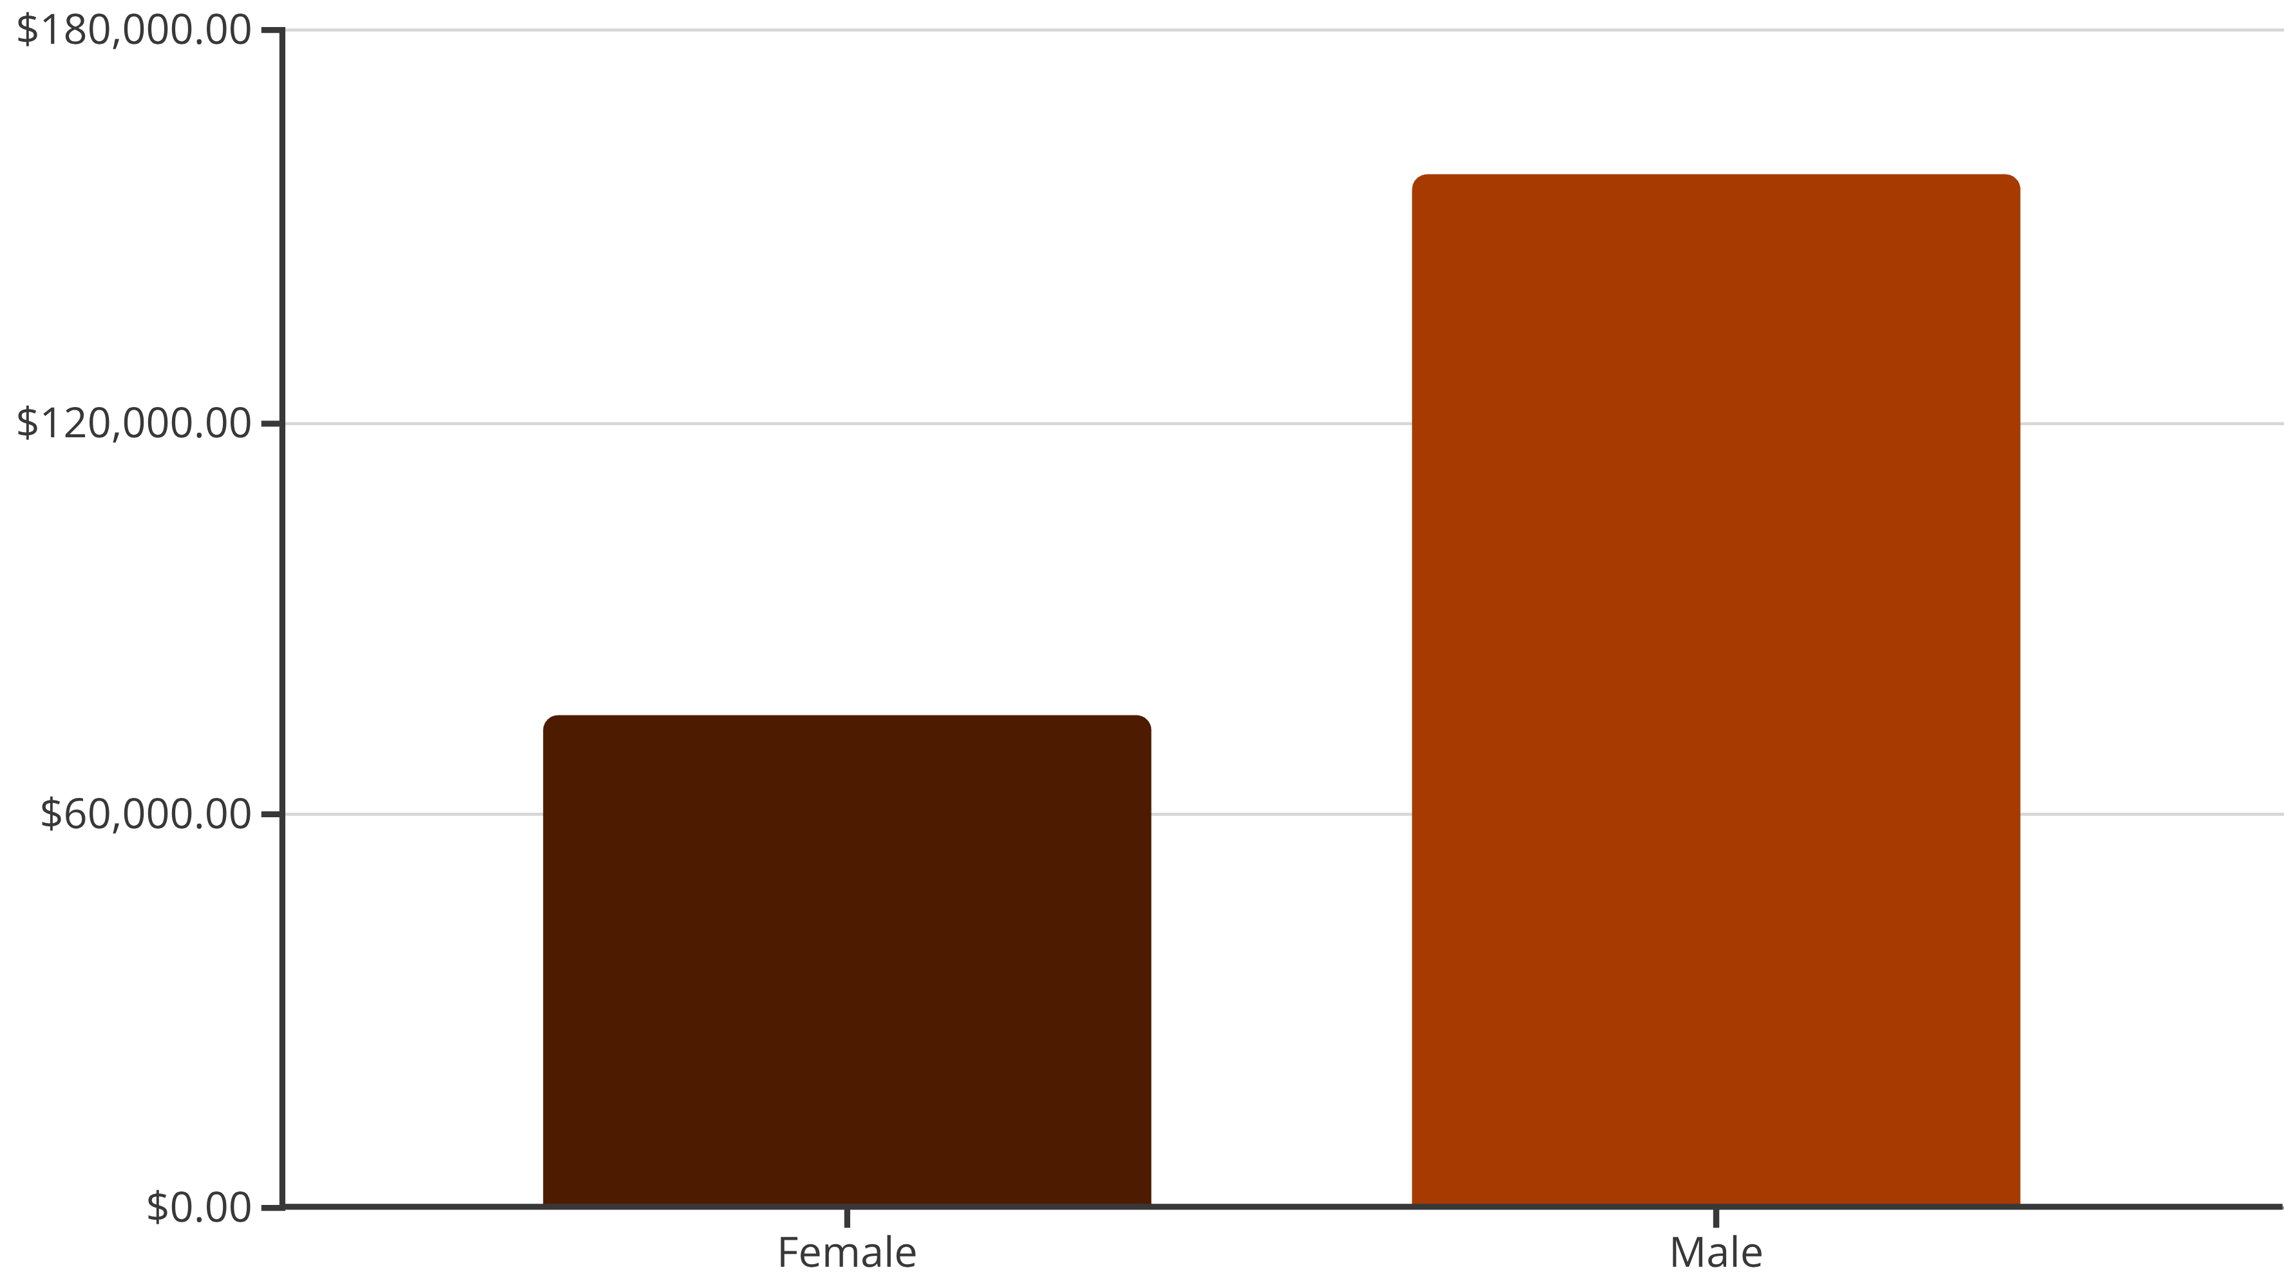
SQL Analysis: Revenue by Gender
Male customers generated significantly higher revenue.

Slide 6

SQL Analysis: Top Products & Shipping
Top 5 Products by Rating
Shipping Type Comparison
Gloves: 3.86
Sandals: 3.84
Standard: $58.46 (Avg. Purchase)
Boots: 3.82
Hat: 3.80
Express: $60.48 (Avg. Purchase)
Skirt: 3.78

Slide 7



SQL Analysis: Subscription & Discounts
Subscribers vs. Non-Subscribers
Discount-Dependent Products
Non-subscribers have higher total revenue ($170,436) and slightly higher average spend ($59.87) than subscribers ($62,645 total, $59.49 avg.).
Hat (50%), Sneakers (49.66%), Coat (49.07%), Sweater (48.17%), Pants (47.37%) had highest discount rates.

Slide 8






SQL Analysis: Customer Segmentation
New
83 Customers
Loyal
3116 Customers
Returning
701 Customers
Classified customers based on purchase history.

Slide 9
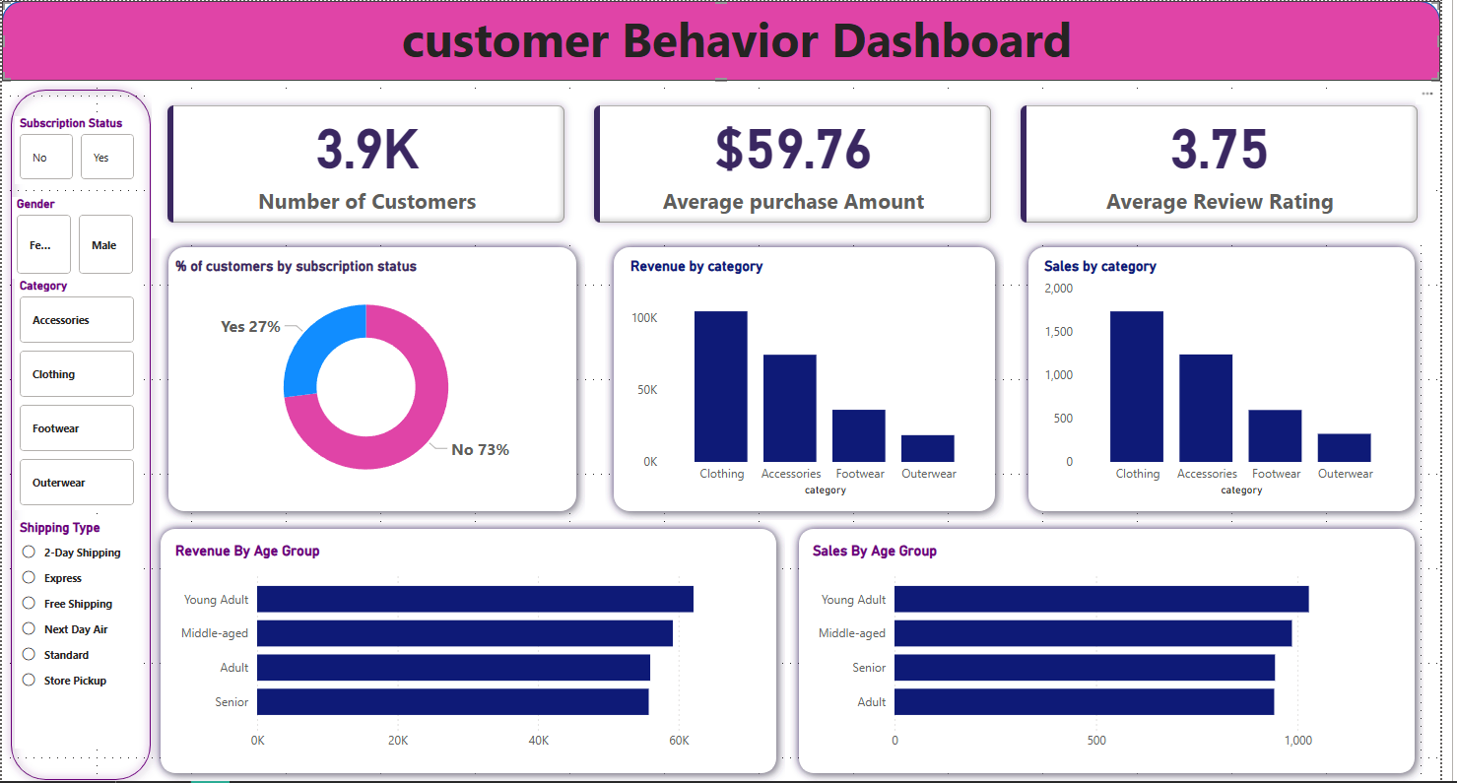
Power BI Dashboard
Interactive dashboard for visual insights.
Visualizing key metrics and trends for easy understanding.

Slide 10

Business Recommendations
Boost Subscriptions
Promote exclusive benefits to increase subscriber base.
Customer Loyalty Programs
Reward repeat buyers to foster loyalty.
Review Discount Policy
Balance sales boosts with margin control.
Product Positioning
Highlight top-rated and best-selling products.
Targeted Marketing
Focus on high-revenue age groups and express-shipping users.

